Slide 1

Unicorn Project
Driving Business Growth

Slide 2
Introduction
The Impact of Discounts on Profitability

Slide 3
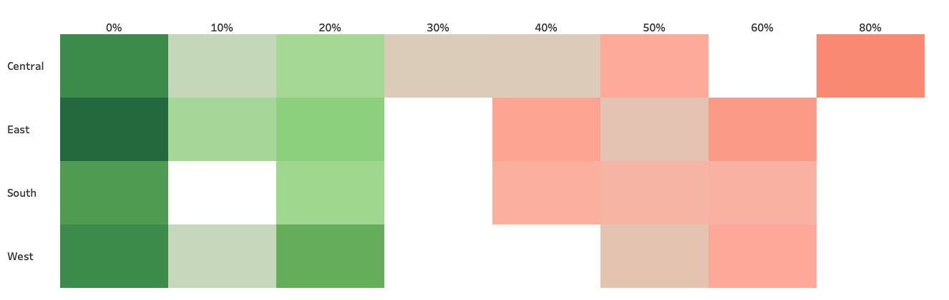
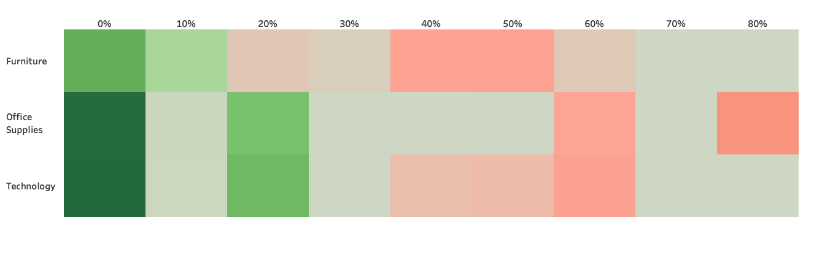
Higher discounts lead to more losses

Slide 4
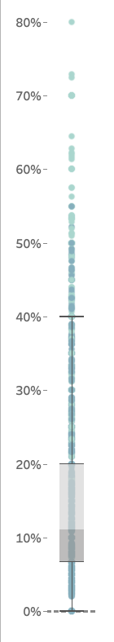
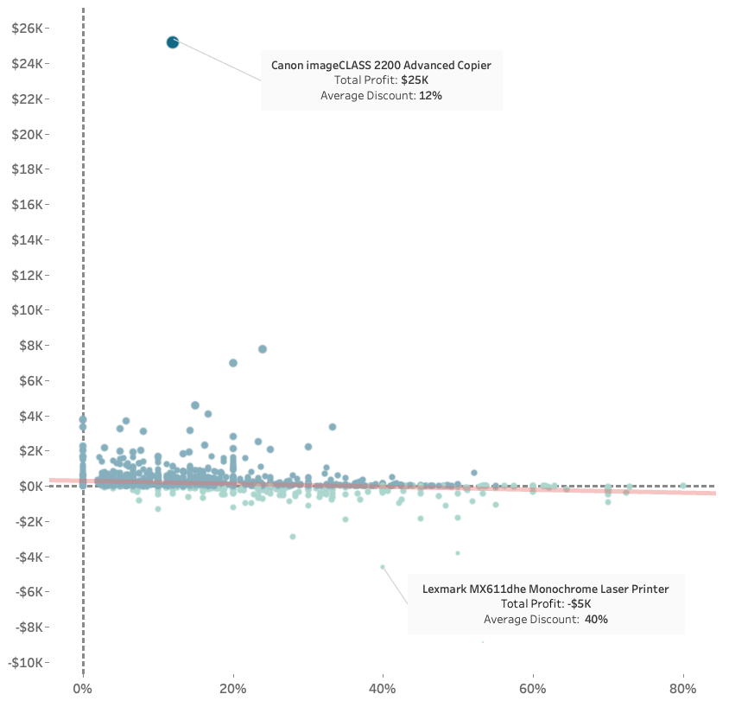
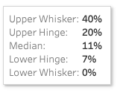
Profitability vs Average Discount

Slide 5

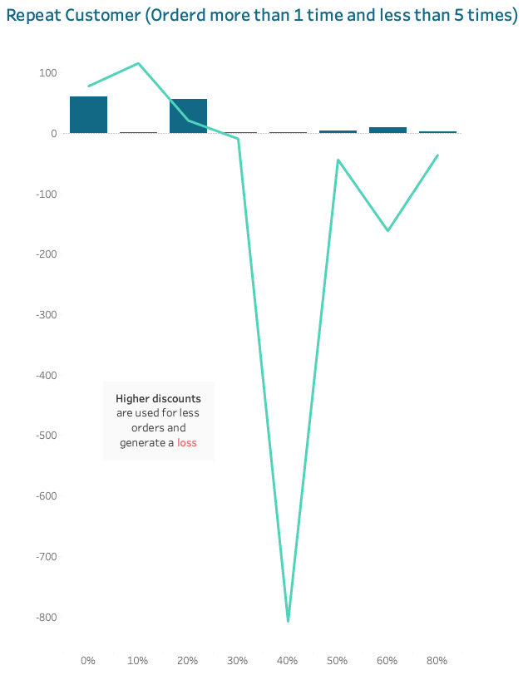
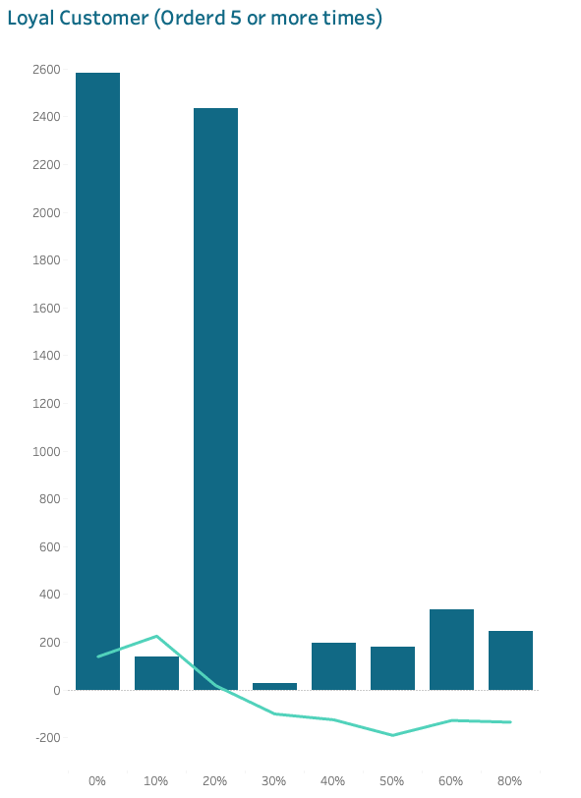
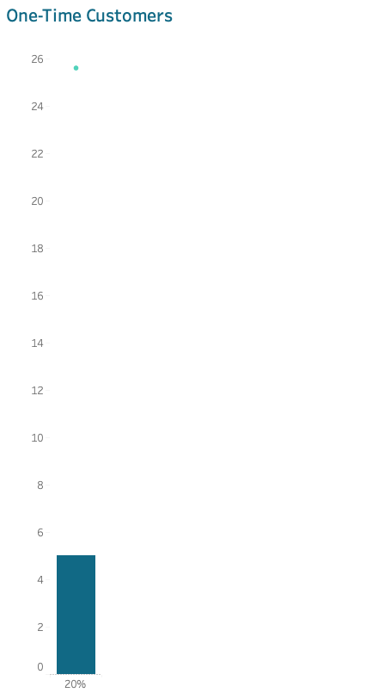
Discount and Average Profit per Order Customer Frequency

Slide 6
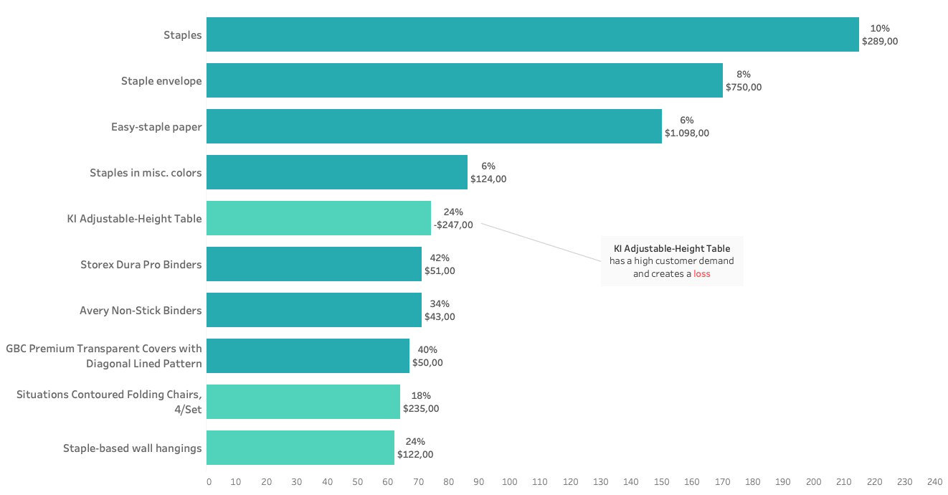

Average Discount Top 10 Products by Quantity

Slide 7
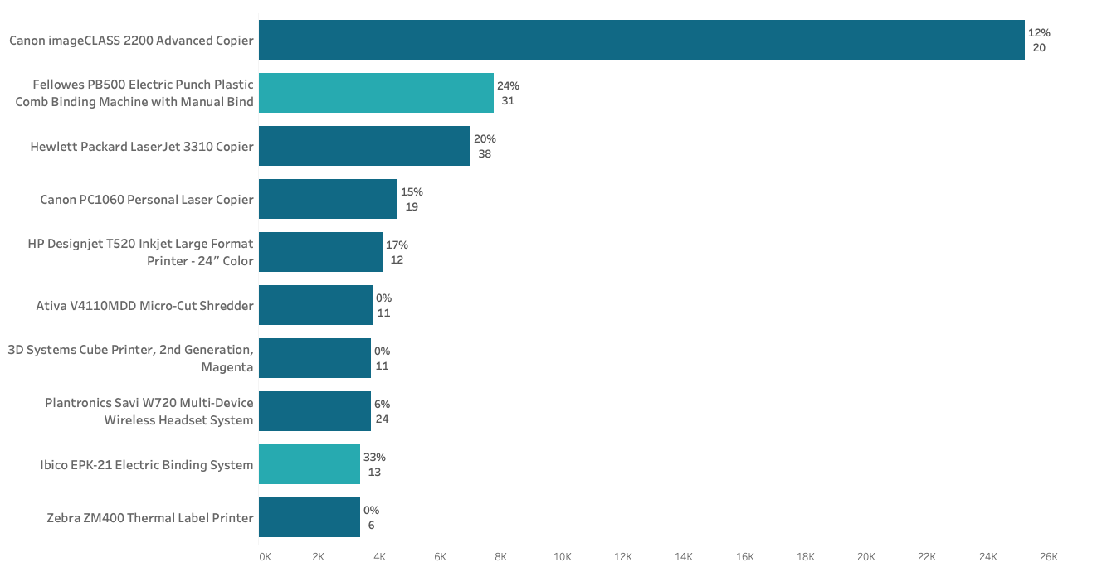
Average Discount Top 10 Products by Profit

Slide 8

Recommendation
Discounts up to 20% are safer, whereas discounts above 40% are risky
Identify products with a high profitability and low discounts and products with a low profitability and big discounts
Offer a premium service with bundle deals and a customer loyalty program with extra discounts up to 10%

